Slide 1
Cubism
Drawing Class

Slide 2
What is Cubism?
Cubism is a specific movement in art history
Cubism started around 1907 and still influences artists today
One of the most famous Cubist artists was Pablo Picasso

Slide 3
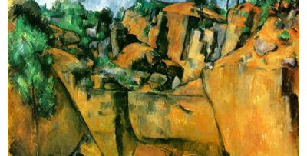
Paul Cezanne
Bibemus Quarry

Slide 4
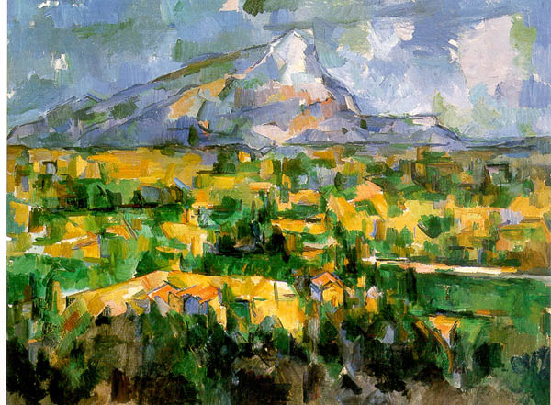

Slide 5
Cubism Traits
In Cubism, pieces are broken up
These pieces are often analyzed, and then reassembled in new and interesting ways
Objects are often shown from multiple viewpoints to show the depth of the object
The background is often shallow, with little depth of space

Slide 6
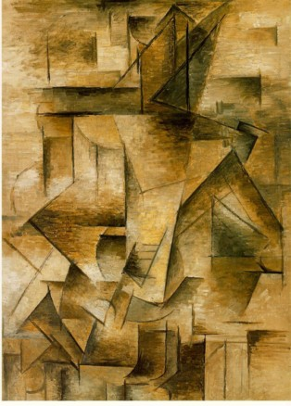
Pablo Picasso
The Guitarist

Slide 7
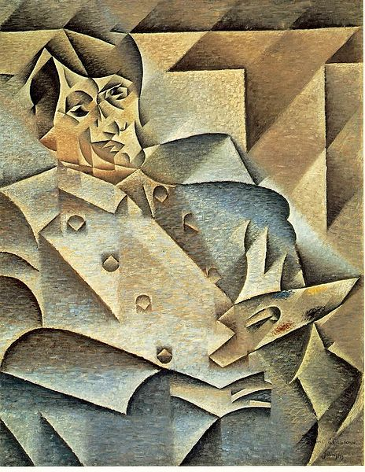
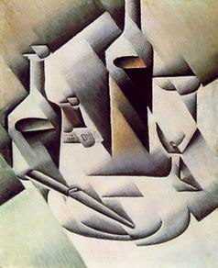
Juan Gris
Portrait of Picasso (right)

Slide 8
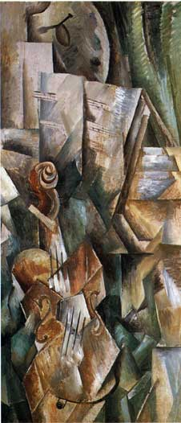
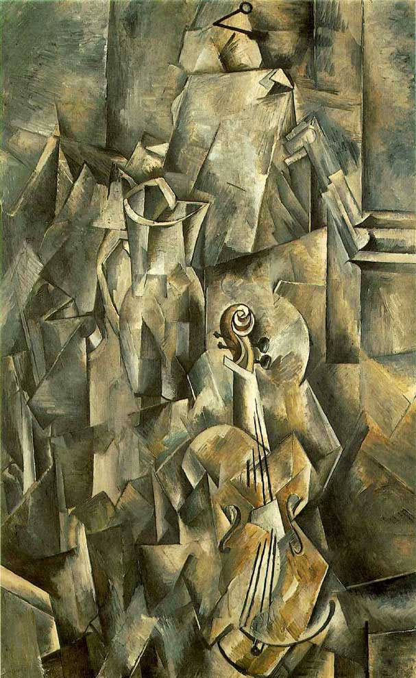
Georges Braque
“Violin with Palette” (left)
“Violin with Pitcher” (right)

Slide 9
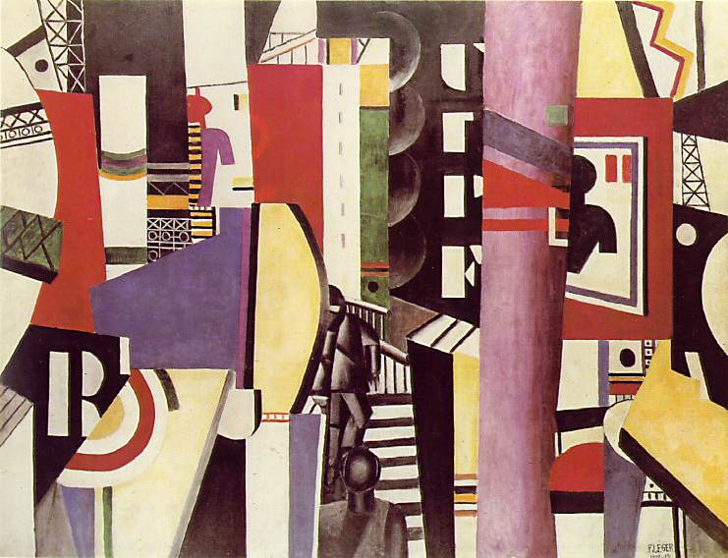
Fernand Leger
The City

Slide 10
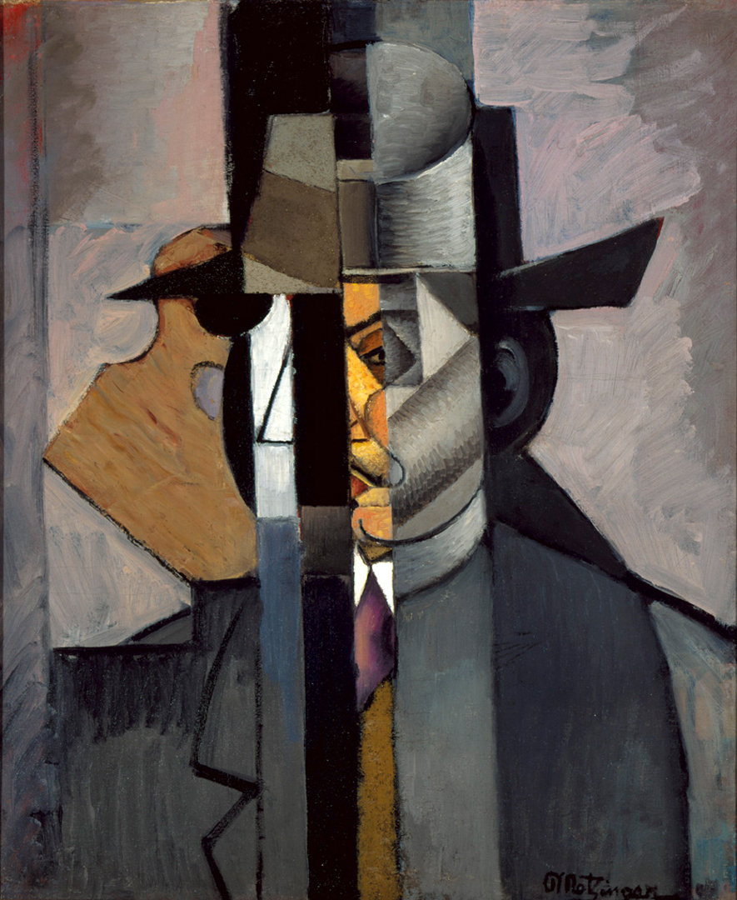
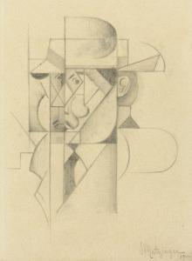
Artist’s Sketch
Jean Metzinger
“Portrait of Albert Gleizes”

Slide 11
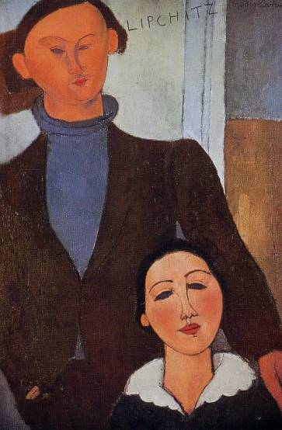
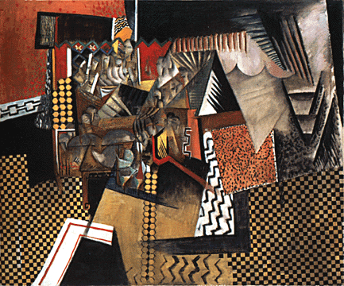
Max Weber
“Chinese Restaurant”
Amedeo Modigliani
“Jacques Lipchitz and his Wife”

Slide 12
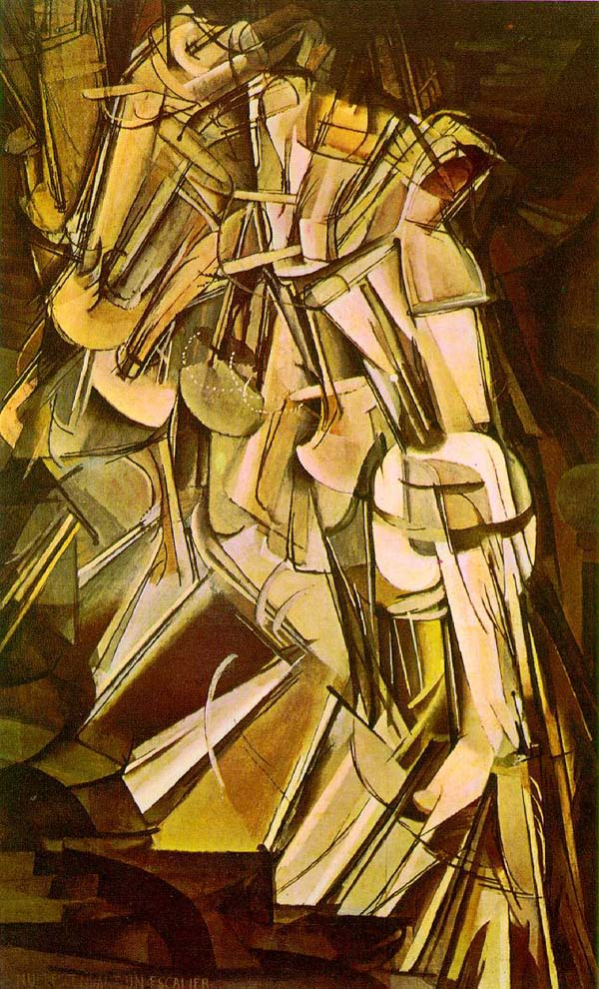
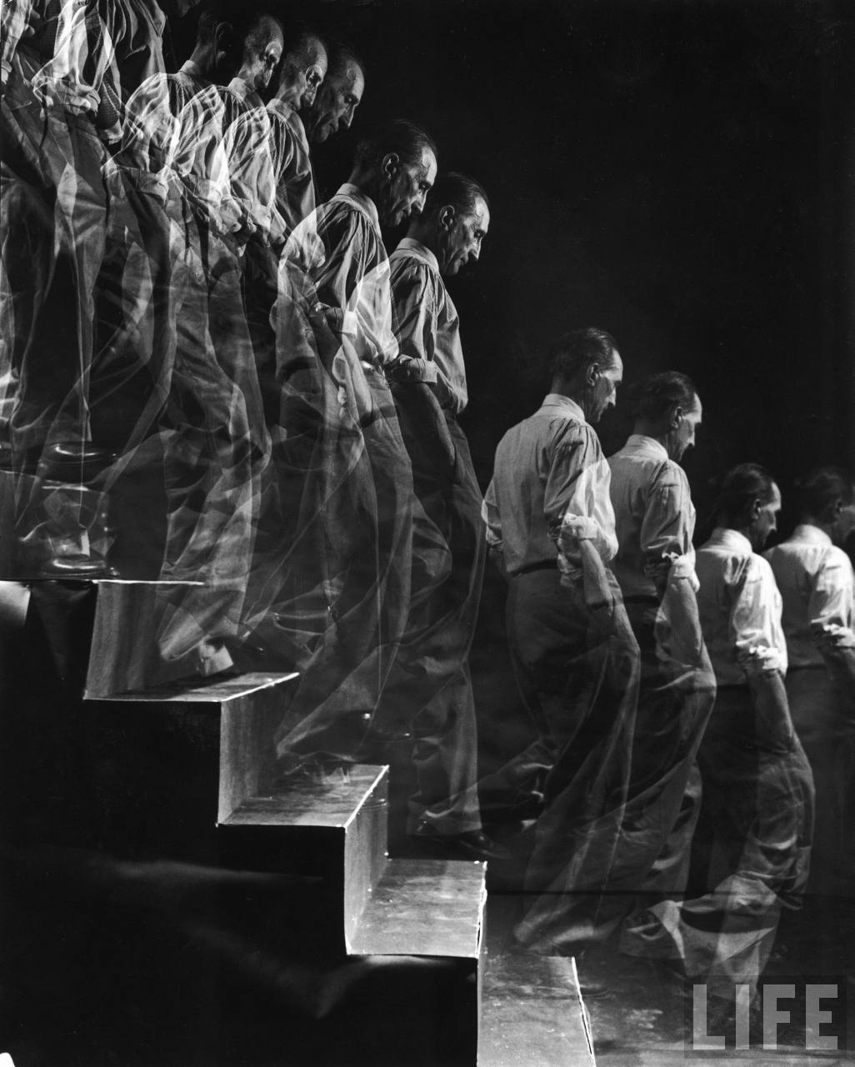
Marcel Duchamp
“Nude Descending a Staircase No.2”

